Slide 1

Malicious URL Detection Using Machine Learning Techniques

Slide 2

Malicious URL Detection Using Machine Learning Techniques
PRESENTED BY
B.LAHARI
HAFIZA
VENU
PUNEETH KUMAR
UNDER THE GUIDANCE OF
Mr. Dr . B. Lakshmi Narayana Reddy, M.Tech, Ph.D.,
Head of Department, CSE(AI &ML).
SRI VENKATESWARA COLLEGE OF ENGINEERING
(approved by AICTE, New Delhi and affiliated to JNTUA, Ananthapuramu)
TIRUPATI-517501,A.P.

Slide 3
Abstract
Currently, the risk of network information insecurity is increasing rapidly in number and level of danger. Propose a malicious URL detection method using machine learning techniques based on our proposed URL behaviors and attributes. A malicious URL is a link created with the purpose of promoting scams, attacks, and frauds. The proposed detection system consists of a new set of URLs features and behaviors, a machine learning algorithm, and a bigdata technology.

Slide 4

Agenda
INTRODUCTION​
OBJECTIVE
EXISTING SYSTEM
DISADVANTAGES OF THE EXISTING SYSTEM
PROPOSED SYSTEM
ADVANTAGES OF THE PROPOSED SYSTEM​
SYSTEM REQUIREMENTS
APPLICATIONS
UML DIAGRAMS
MODULE IMPLEMENTATION
TEST TECHNIQUES
TEST CASES
PROJECT OUTPUT (SCREENSHOTS)
CONCLUSION
FUTURE ENHANCEMENTS

Slide 5
Introduction
With the rapid growth of digitalization, cybercriminals have taken advantage of the internet to launch various attacks. One of the most common tactics is the use of malicious URLs to trick individuals and systems into revealing sensitive information, such as personal identity data and financial account details. Phishing is a form of cybercrime that relies on social engineering to deceive victims. Attackers create fake but convincing websites or messages to steal login credentials, credit card information, and other sensitive data.

Slide 6
Objectives
The objective of the project is to classify URLs based on the features and behaviors of URLs.
Protecting the user network from malicious attacks.
Prevents users from unauthorized access to the network.
Detecting malicious URLs with machine learning to protect users from cyber threats.

Slide 7
Existing System
A popular approach in detecting malicious activity on the web is by leveraging distinguishing features between malicious and benign DNS usage. Both passive DNS monitoring and active DNS probing methods have been used to identify malicious domains. The best-known non-proprietary content-based approach to detect phishing webpages is Cantina.

Slide 8
Disadvantages of an Existing System
DNS-based mechanisms do not provide a deeper understanding of the specific activity implemented by a webpage or domain.
Downloading and executing each webpage impacts performance and hinders the scalability of dynamic approaches.
URL-based techniques usually suffer from high false positive rates.
Finally, existing techniques do not account for new mobile threats such as known fraud phone numbers that attempt to trigger the dialer on the phone.

Slide 9
Proposed System
In the proposed system, machine learning algorithms are used to classify URLs based on the features and behaviors of URLs. The features are extracted from static and dynamic behaviors of URLs and are new to the literature. Those newly proposed features are the main contribution of the research. Machine learning algorithms are a part of the whole malicious and phishing URL detection system. Three supervised machine learning algorithms are used, Support vector machine, Random forest and Logistic Regression.

Slide 10
Advantages
Protecting the user network from malicious attacks.
Prevents users from unauthorized access to the network.
Securing confidential information
In the proposed work, SVM is selected as an example to illustrate the good performance of the whole detection system and is not our main focus.

Slide 11
System Requirements
HARDWARE | SOFTWARE
System | I5 Processor
Hard Disk | 500 GB
RAM | 2 GB
Operating System | Windows 11
Server | WampServer
Programming | Python

Slide 12
Unified Modeling Language Diagrams
UML is a standardized modeling language. It is used in software engineering. It provides a way to visualize system designs. UML helps to communicate complex architectures. Various diagrams capture different aspects.

Slide 13
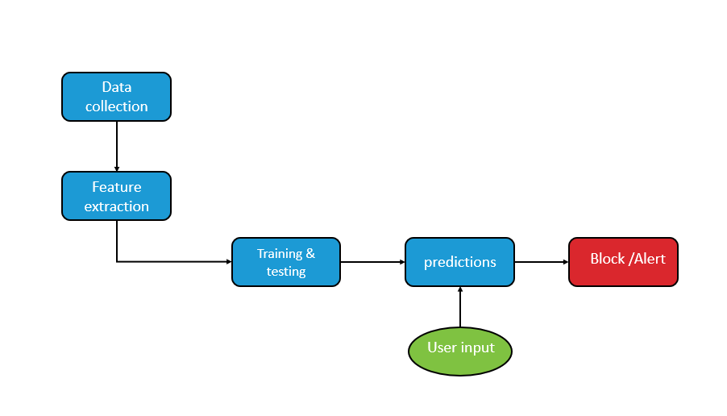
System Architecture For Malicious URL Detection

Slide 14
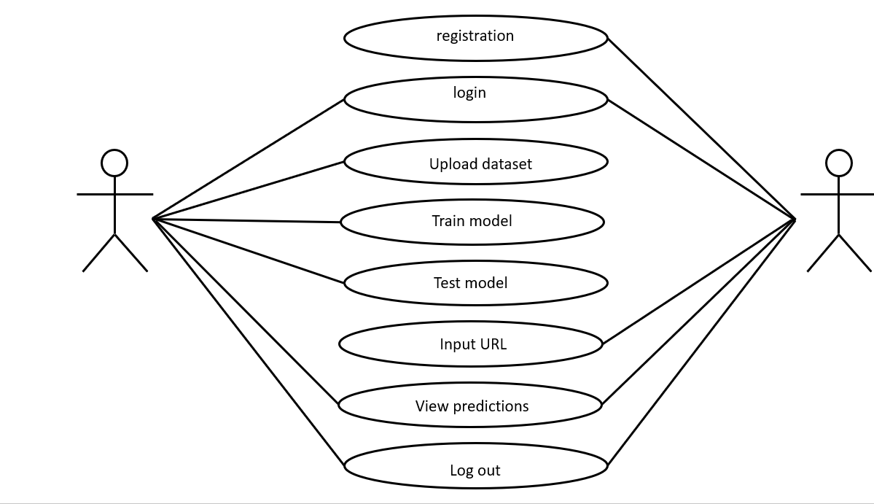
Use case Diagram

Slide 15
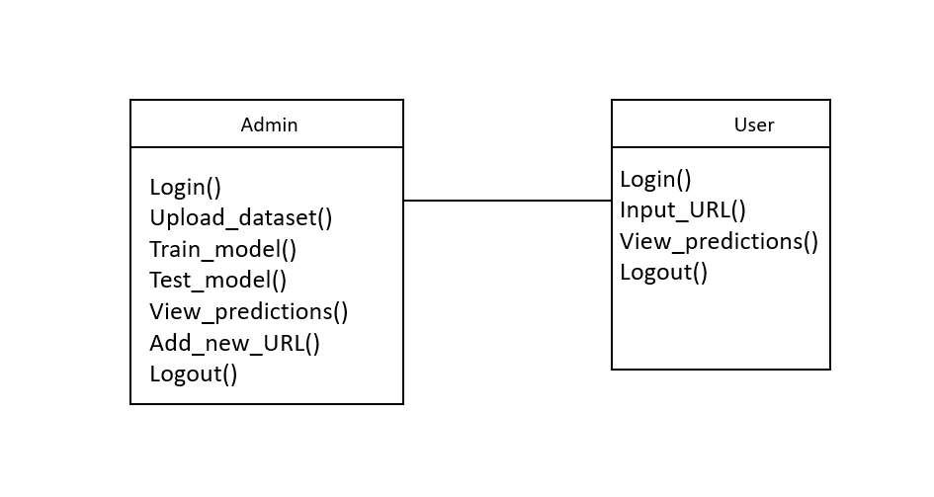
Class diagram

Slide 16
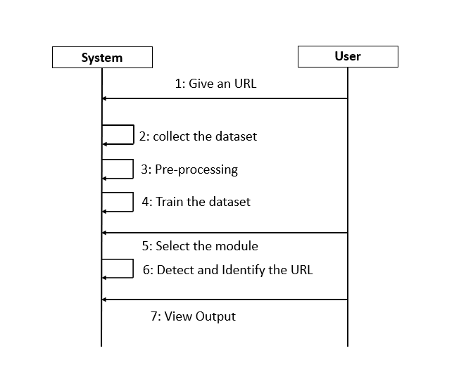
Sequence Diagram

Slide 17
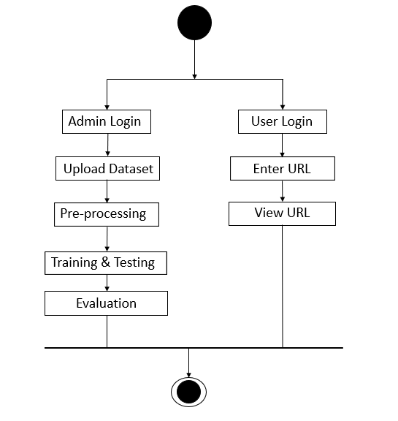
ACTIVITY DIAGRAM

Slide 18
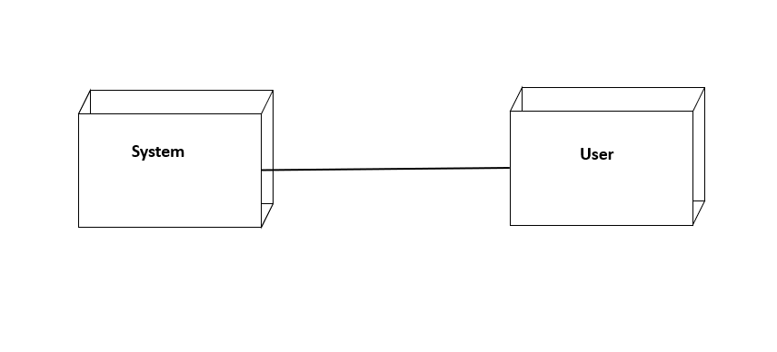
Deployment Diagram

Slide 19
Modules
Data Collection
Data Preprocessing
Train and Test Modeling
Detect Malicious URL’s

Slide 20
Data Collection
The dataset for Malicious URL prediction is collected from the Kaggle website.
we collected sufficient data samples and legitimate software samples.
We split the data into Training and Testing, where the Training dataset is for training the model Testing is for evaluating the model.

Slide 21
Data Preprocessing
Once data is gathered, it needs to be pre-processed, cleaned, constructed, and formatted in a style that can work.
Data Processing techniques Provide cleaning of Data Samples that will be used for better performance.
After data is preprocessed, it is added to the Malicious URL dataset, which can be used for training and testing purposes.

Slide 22
Train and Test Modeling
We Split the data into train and test data Train will be used for training the model and Test data to check the performance
The ratio of 80:20 is a common split in Machine Learning because it provides enough data for training while keeping a sufficient portion for testing.
We use the preprocessed training dataset to train our model using Algorithms.

Slide 23
Evaluate and Detect Malicious URL’s
Models are evaluated using classification reports and confusion matrices, like precision, recall, and F1 score and measure the accuracy by identifying the Malicious URL accurately.
Based on the model trained algorithm we will detect whether the given URL is Phishing or Malicious.

Slide 24
TESTING TECHNIQUES
Unit Testing
Unit testing is a software testing method where individual units or components of a software application are tested in isolation to validate their correctness and functionality. It aims to ensure that each unit behaves as expected according to its design.
Integration Testing
Integration testing is also a software testing method, ensures that different parts of a software system work together smoothly. It makes interactions and interfaces between these units to detect any integration issues.

Slide 25
Validation Testing
Validation testing verifies that the software meets the requirements and fulfills the intended purpose, ensuring it satisfies the needs of the end-users. It validates the overall behaviour and performance of the software against specified criteria.

Slide 26
Test Cases
S. No. | TEST CASES | INPUT | EXPECTED RESULT | ACTUAL RESULT | STATUS
1 | User Registration | Enter all fields | User gets registered | Registration is successful | pass
2 | User Registration | if user miss any field | User not registered | Registration is un successful | fail
3 | Admin Login | Give the user name and password | Admin home page should be opened | Admin home Page has been opened | Pass
4 | Upload url Dataset | Test whether the url Dataset is uploaded or not into the system | If url Dataset is not uploaded | We cannot do further operations | Pass
5 | Preprocess Dataset | Verify the Dataset is Per – processed or not | Without loading the dataset | We cannot Per-processing Dataset | Pass
6 | Run SVM algorithm | Verify the SVM algorithm will run or not | Without training model | We cannot run SVM algorithm | Pass

Slide 27
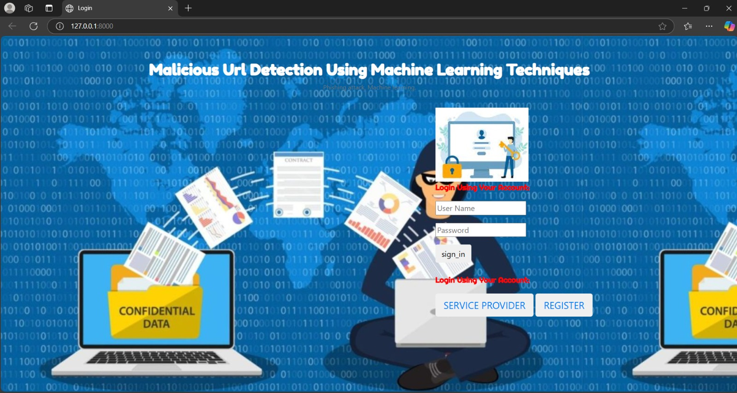
Output Screens

Slide 28
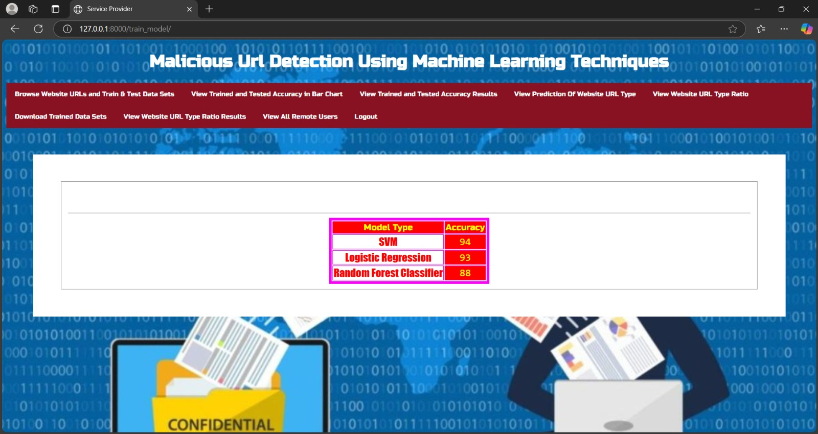

Slide 29
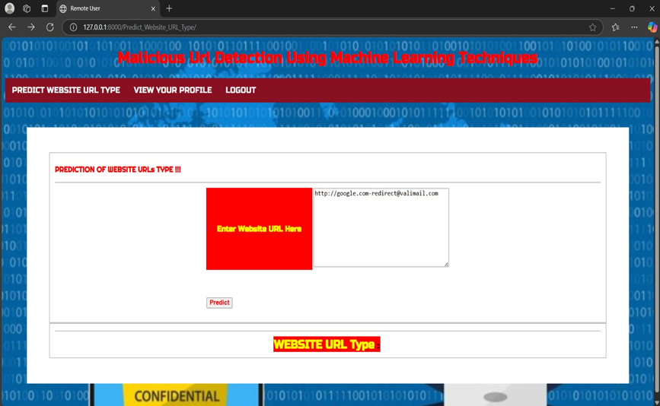

Slide 30


Slide 31
Conclusion
In conclusion, developing and implementing machine learning techniques for malicious URL detection such as phishing URLs show promising results in enhancing cybersecurity measures.
Through the use of supervised learning algorithm such as support vector machines, along with feature engineering and selection methods, it is possible to classify URLs as benign or malicious effectively.

Slide 32
Future Scope
Developing more advanced deep learning architectures tailored for URL classification tasks.
Improving model robustness against sophisticated adversarial attacks.
Developing algorithms for scalable, real-time detection of malicious URLs to respond promptly to threats.

Slide 33
THANK YOU

